Slide 1
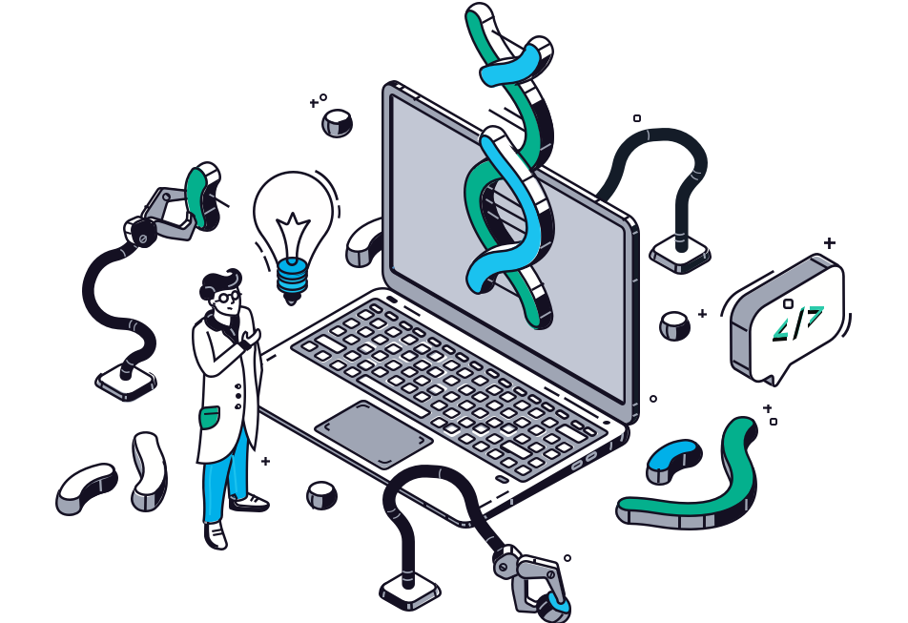


RP14: Clinical pathway discovery based on electronic health record data
Praveen Jagan Nath
Fachhochschule Dortmund
Prof. DR. Britta Böckmann, Prof. Dr. Christoph M. Friedrich, Prof. Dr. Elizabeth Livingstone

Slide 2
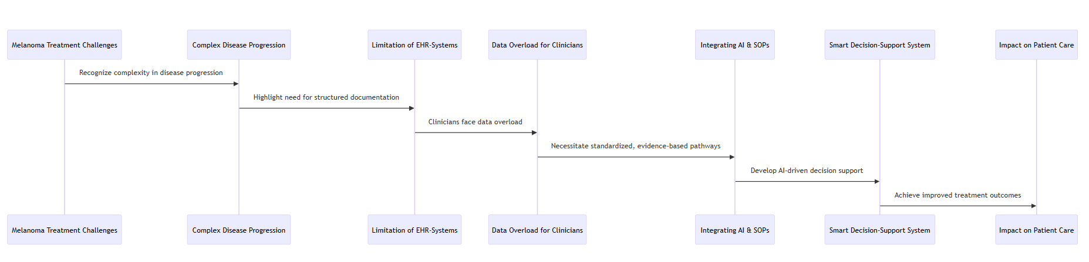
Introduction

Slide 3
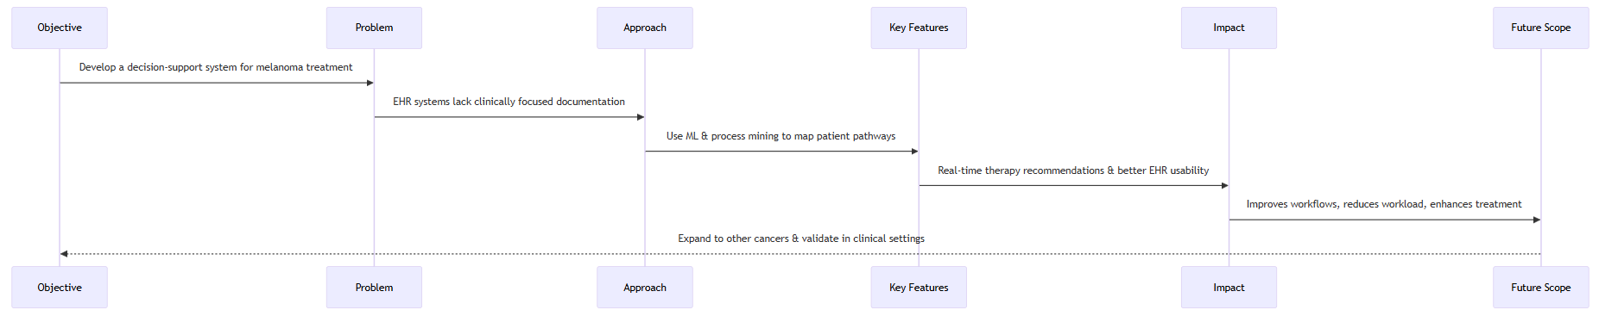
Project Description

Slide 4


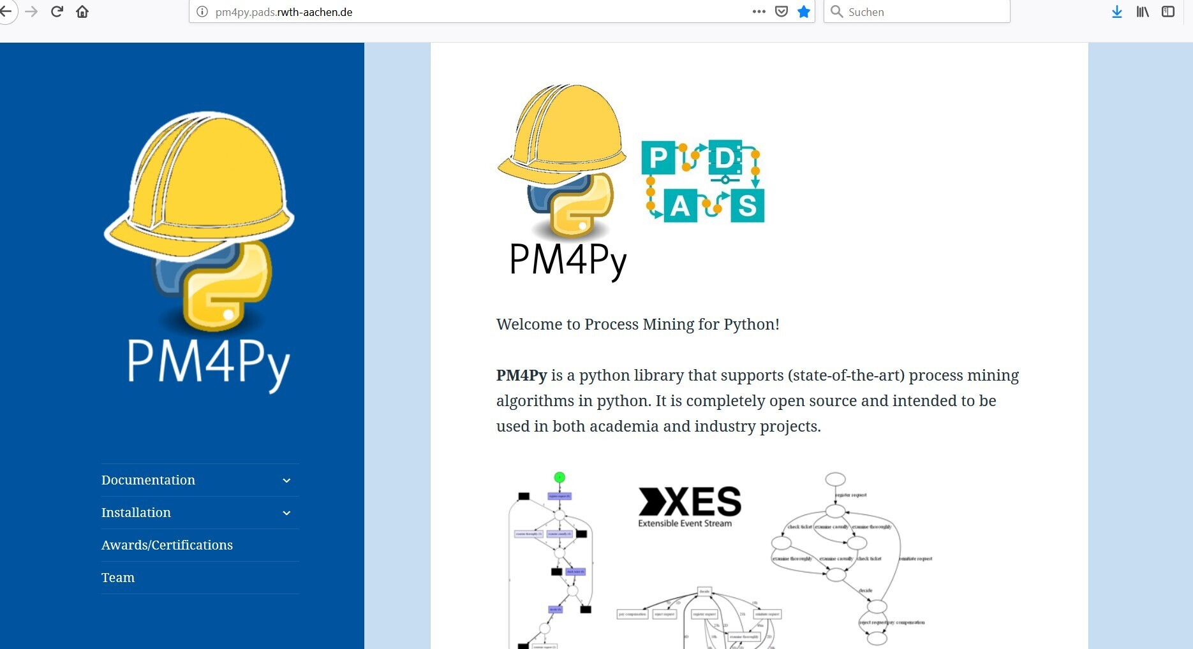
Materials and Methods
Data source
EHR data from SHIP (database) health records (UK Essen )
Process Mining
Extracts patient pathways using event logs and BPMN models.
Machine learning
Uses HMMs, VAEs, and PAEs to predict treatment steps.
SOPs & Guidelines Integration
Aligns patient pathways with gold-standard protocols for consistent, evidence-based care
FHIR Integration
Structures and standardizes patient data for analysis.
Ethical Consideration
Ensures data privacy, security, and compliance.

Slide 5
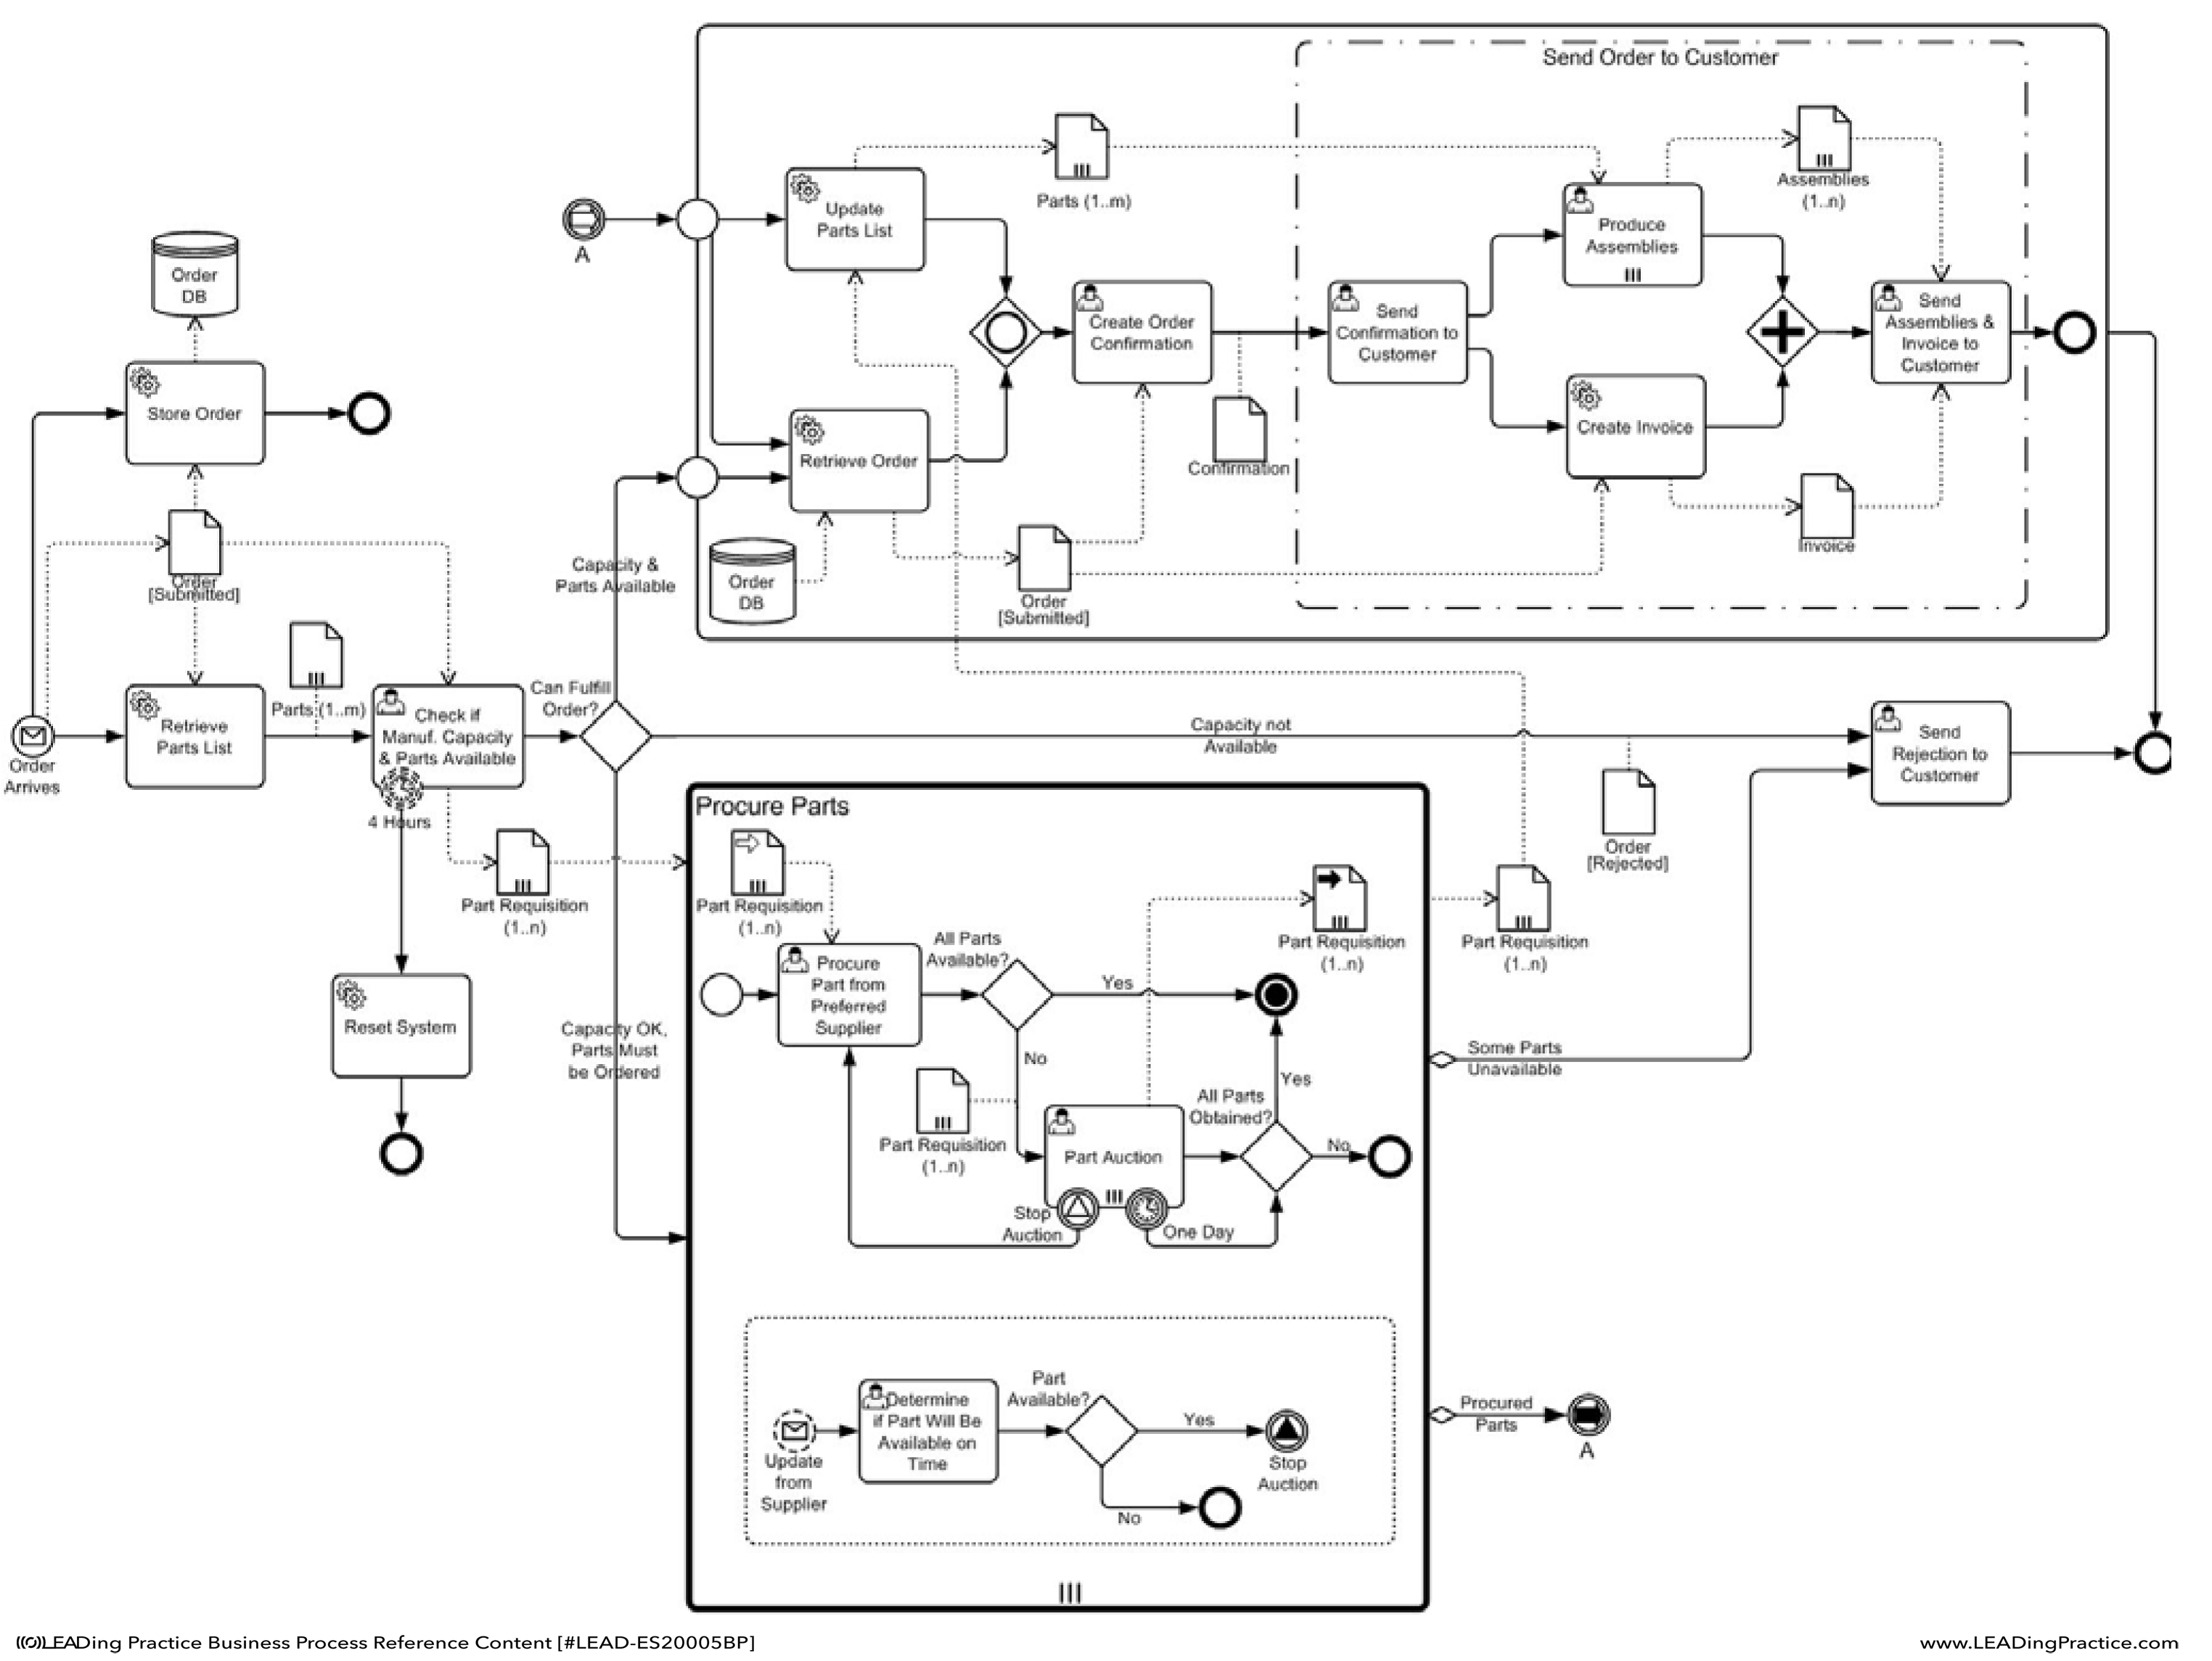
Schematic Representation of RP14
Data Accessibillity
Log extraction
Melanoma SOP
Compare
Export
Discovery
Compare
Decision Support
FHIR-PYRATE
FHIR-METRICS
HMMs/
VPAEs
Consensus
Pathway
BPMN individual pathways
We use process mining to extract event logs from SHIP (database) health records (UK Essen ) and visualize them as BPMN models. Techniques such as Hidden Markov Models and Variational Predictive Autoencoders will reveal patient pathways, enabling real-time comparison of clinical journeys with SOPs to guide optimal treatment decisions."

Slide 6
Aims
Integrate Real- Time Data with SOPs
Enhance Patient Specific Decision Making
Improve EHR Data Accessibility
Develop Machine learning-Driven Predictive Models
Standardize Clinical Pathways
Validate and implement in Clinical Settings

Slide 7
Planned Timelines
Phase 1
Phase 2
Phase 3
Phase4
Phase 5
Months 1-7
Months 8-14
Months 15-20
Months 21-24
Months 25-
Research and accessibility to Data
Created Data Cohort and Process Mining Module to use.
AI Model development
System Integration and Optimization
Validation and clinical testing
Study FHIR data structure
Extracted event logs and BPMN model
Train HMMs, VAEs and PAEs for treatment Prediction
Implement the made decision support system
Testing in real- world clinical system
Conducted Literature review on Process mining
Implement initial PM module in the cohort
Use Stochastic Modeling for disease progression analysis
Refine data accessibility within EHRs for real time recommendations
Assess Impact on workflow efficiency and treatment accuracy

